Slide 1

MACHINE LEARNING REGRESSION
SIMPLE LINEAR REGRESSION

Slide 2

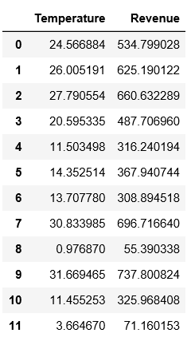

SIMPLE LINEAR REGRESSION: INTUITION
In simple linear regression, we predict the value of one variable Y based on another variable X.
X is called the independent variable and Y is called the dependant variable.
Why simple? Because it examines relationship between two variables only.
Why linear? when the independent variable increases (or decreases), the dependent variable increases (or decreases) in a linear fashion.
REVENUE($)
TEMPERATURE (DegC)
2
Source: https://www.goodfreephotos.com/vector-images/ice-cream-stand-vector-clipart.png.php

Slide 3

SIMPLE LINEAR REGRESSION: SOME MATH!
Goal is to obtain a relationship (model) between outside air temperature and ice cream sales revenue
MODEL! (GOAL)
REVENUE($)
$$y=b+m∗x$$
$20
DEPENDANT VARIABLE
REVENUE ($)
INDEPENDENT VARIABLE
TEMPERATURE (DegC)
+10 degC
TEMPERATURE (DegC)

Slide 4
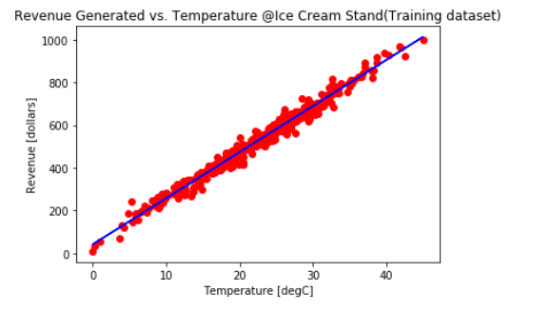





HOW ARE WE GOING TO USE THE MODEL?
Once the coefficients m and b are obtained, you have obtained a simple linear regression model!
This “trained” model can be later used to predict any Revenue (dollars) based on the outside air Temperature.
$$\text{y}\text{ = }\text{mX}\text{+}\text{b}$$
$$Y$$
DEPENDANT
VARIABLE
INDEPENDANT
VARIABLE
$$m$$
$$b$$
$$X$$

Slide 5






SIMPLE LINEAR REGRESSION: QUIZ
Match the equations to the figures:
$$y=3∗x$$
$$y=15−10∗x$$
$$y$$
$$y$$
$$x$$
$$x$$

Slide 6
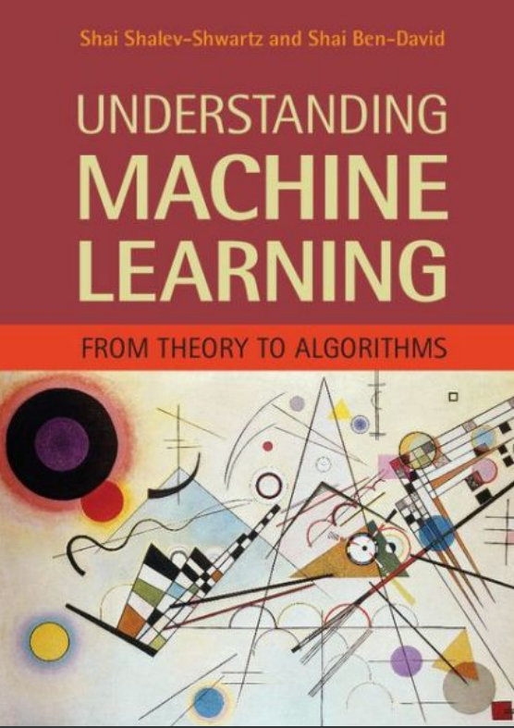
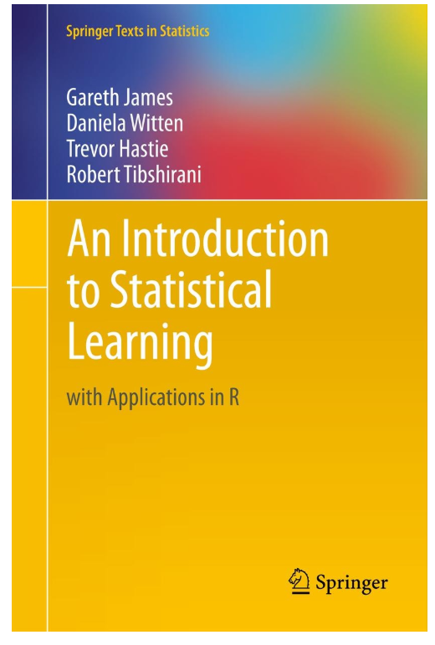
SIMPLE LINEAR REGRESSION: ADDITIONAL READING MATERIAL
Additional Resources, Page #123: http://www.cs.huji.ac.il/~shais/UnderstandingMachineLearning/understanding-machine-learning-theory-algorithms.pdf
Additional Resources, Page #61:
http://www-bcf.usc.edu/~gareth/ISL/ISLR%20Seventh%20Printing.pdf

Slide 7
LEAST SQUARES

Slide 8
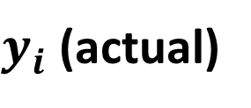


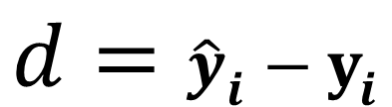
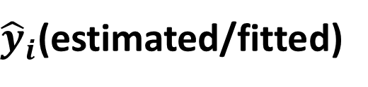
SIMPLE LINEAR REGRESSION: HOW TO OBTAIN MODEL PARAMETERS? LEAST SUM OF SQUARES
Least squares fitting is a way to find the best fit curve or line for a set of points.
The sum of the squares of the offsets (residuals) are used to estimate the best fit curve or line.
Least squares method is used to obtain the coefficients m and b.
$y_{i}$ (actual)
$$d$$
$$d={\hat{y}}_{i}−y_{i}$$
REVENUE($)
${\hat{y}}_{i}$(estimated/fitted)
$$min\sum{{\left({\hat{y}}_{i}−y_{i}\right)}^{2} }$$
TEMPERATURE (DegC)
MINIMUM (LEAST) SUM OF SQUARES

Slide 9
SIMPLE LINEAR REGRESSION: TRAINING VS. TESTING DATASET
Data set is divided into 75% for training and 25% for testing.
Training set: used for model training.
Testing set: used for testing trained model. Make sure that the testing dataset has never been seen by the trained model before.
75 TRAINING SAMPLES
100 SAMPLES
25 TESTING SAMPLES

Slide 10
SIMPLE LINEAR REGRESSION: ADDITIONAL READING MATERIAL
Additional Resources, Page #124: http://www.cs.huji.ac.il/~shais/UnderstandingMachineLearning/understanding-machine-learning-theory-algorithms.pdf
Additional Resources, Page #62:
http://www-bcf.usc.edu/~gareth/ISL/ISLR%20Seventh%20Printing.pdf

